Slide 1
IAU
Introduction to Pyhon an some libraries

Slide 2
Todays agenda
Reproducible research
Introduction to the Python language
Introduction to application of libraries Numpy and Pandas

Slide 3
Questions and feedback
slido.com#iau2018-w02
tinyurl.com/iau2018-19

Slide 4
Difficult Reproducible research
Collect data and save as CSV
Look into the data using your favorite tool (eg. Excel, SQL)
Raw data
Basic graphs
Pivot table
Edit data manually (correct missing data, remove nonsenses, correct format ...).
If you are writing Excel expert level into your CV you could even create some macros
If necessary, repeat from step 2
Finish the task you were supposed to at the beginning and deliver results

Slide 5
What would happen if I received new data and was supposed to repeat the analysis? What if I have to do some changes in the analysis?
Collect data and save as CSV
Look into the data using your favorite tool (eg. Excel, SQL)
Raw data
Basic graphs
Pivot table
Edit data manually (correct missing data, remove nonsenses, correct format ...).
If you are writing Excel expert level into your CV you could even create some macros
If necessary, repeat from step 2
Finish the task you were supposed to at the beginning and deliver results

Slide 6
Where is the problem?
I have to repeat the whole procedure again.
A lot of manual labor.
I have a vague idea how I proceeded during the first analysis, but I don’t remember exactly.
Somebody reading results of my analysis don’t know how I processed the data to obtain these results.

Slide 7
What would we need
Some script that we would follow to be able to repeat the whole procedure
Ways to automate the processing so we don’t have to do it again manually
In case of new data
In case of necessary changes in the procedure
Optional requirements
We don’t want to create the analysis and create the script after that. We want the script creation to be comfortable and as a part of the analysis
We want to see partial results during the analysis
We want comments
Not only in the code, but also attached to analysis results

Slide 8
Possible solutions
Script / program
Hard to do in Excel
Often used in SQL to transform data. Some transformations can be problematic.
Some general programming language could be useful.
Executable notebooks
Analysis as an executable document
Connection of code, text and visualizations

Slide 9
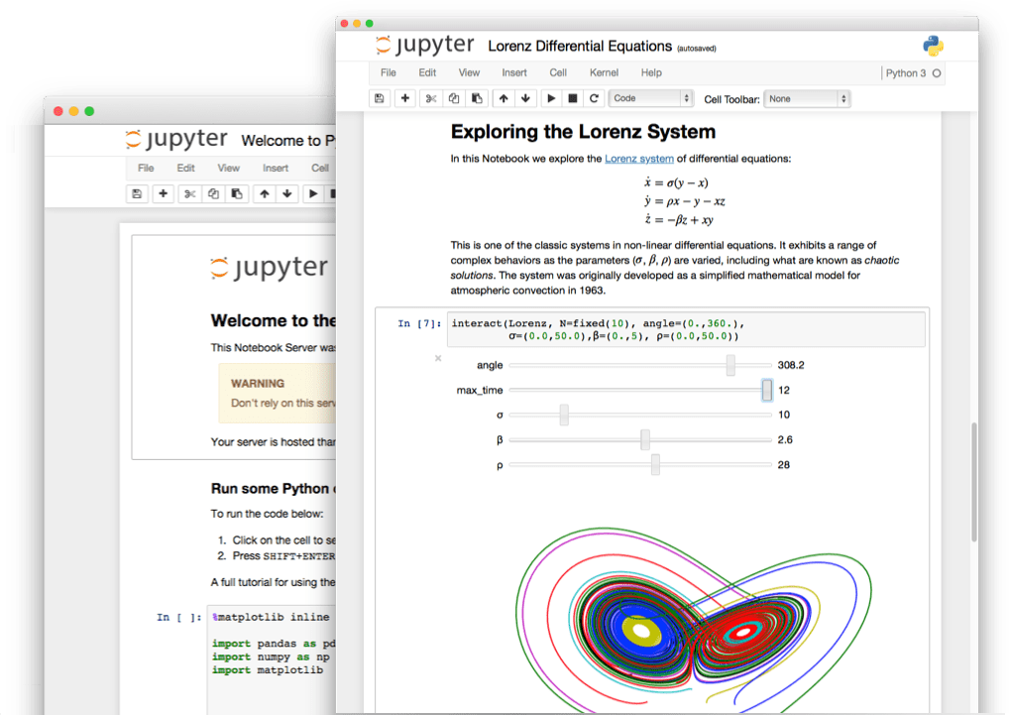
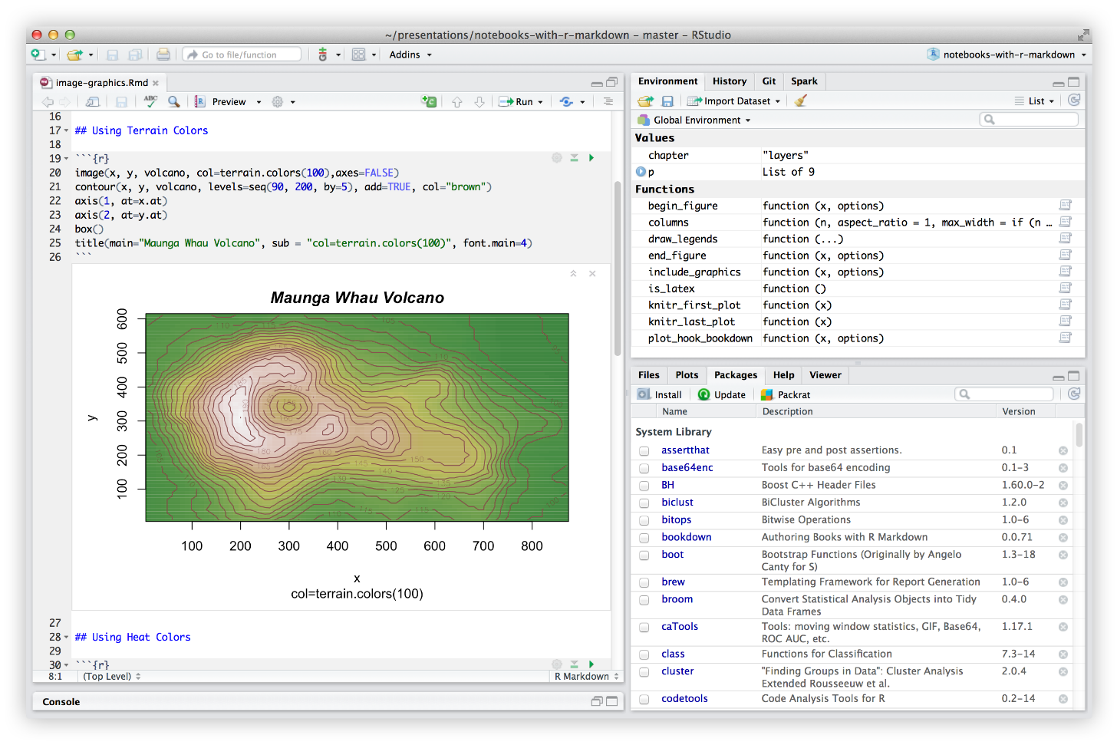
Executable notebooks
Jupyter
R Markdown

Slide 10
Example of a Jupyter notebook
Repository of notebooks: https://github.com/donnemartin/data-science-ipython-notebooks
Notebook: https://github.com/donnemartin/data-science-ipython-notebooks/blob/master/kaggle/titanic.ipynb
Instead of python 2, we use python 3 so we added the line
%matplotlib inline
after loading packages

Slide 11
In this document is the whole analysis which anyone can read and rerun
We can see:
Results
Procedure
Comments and interpretation of results
Data preprocessing and transformations

Slide 12
Similar documents will be the result of your project
Executable / reproducible / reusable
Complete
The whole proprocessing.
There is no manual entry editing nowhere in the process
If you use some other tool for partial processing, it is necessary to add script or complete description of performed steps
All used functions and libraries have to be freely accessible or directly attached
Data processing procedure is commented and results are interpreted výsledky
Code only is not enough
Precomputed results are saved in the document
Reader is not obliged to run the code to see results
Not necessary to have everything stored in a single document.
Function definitions can be imported using standard import calls available in the programming language
Individual parts of the analysis can be divided into separate notebooks and connected by data exports / imports.
Data have to be available, attached to the code or at least provided complete description of steps necessary to acquire them

Slide 13
Examples of other notebooks
https://github.com/jupyter/jupyter/wiki/A-gallery-of-interesting-Jupyter-Notebooks

Slide 14
We will continue with introduction to Python programming language

